Slide 1
CONTROLLING PC via
VOICE
MEGHANA KANDRU
BACHELOR OF TECHNOLOGY
IN
COMPUTER SCIENCE & ENGINEERING

Slide 2
INTRODUCTION
As it is the application based program by which we can operate the windows and quickly launch the basic required command by just saying the command name or the basic utility which we want to open. The easy way of interacting with the computer is provided by our application. This project is very helpful to the person who is lame and wants to operate the computer by the help of voice. It provide the facility of opening, closing, saving and many more short commands to operate the windows. So this facility is quite effective.
This project is also helpful to the person who is tiered from operating the windows through keypad or mouse, he can use this software to easy and comfortable operation of the windows .This project helps by just enabling the windows by voice commands

Slide 3
WHY TO USE THIS PROJECT ?
This service is available at any time.
The main advantage of this project is that it does not require any LAN or WAN connection and any knowledge of database handling.
It is very cheap in price.
It is one of the best methods for handling database service.
The basic utilities like notepad, paint ,calculator etc can be opened within seconds by this software.

Slide 4
Purpose and scope
This is a desktop application which means it has to be installed on any machine to get it in a working state.
The application shall help you to retrieve data via human voice in natural language.
The software can be used by any user, there is not any specific requirement for an operating system but then it has to be at least Microsoft.
This software is also being able to generate database.
Easy to use.

Slide 5
Analysis and Explanation of
Identified Problem
Speech Recognition is a technology that allows the computer to identify and understand words spoken
by person using a microphone or telephone.
The ultimate goal of the technology is to be able the
basic utility software within the few seconds by just
saying the name of that utility.

Slide 6
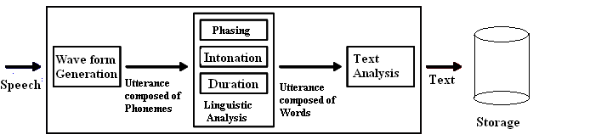
Analysis and Explanation of
Identified Problem (cont..)
In first step speech is converted into text. Steps are
shown in the figure.

Slide 7
Literature Review
Speech Synthesis: It provides the reverse process of producing synthetic speech from text generated by an application ,applet or a user. It is often referred to as text to speech technology.
The major steps involved are :
1.Structure Analysis
2.Text pre processing

Slide 8
Literature Review (Cont..)
Speech Recognition : It provides computers with the ability to listen to spoken language and determine what has been said.
In other words , it processes audio input containing
speech by converting it to text.
The major steps are :
1.Grammar Design
2.Signal processing
3.Phoneme Recognition

Slide 9
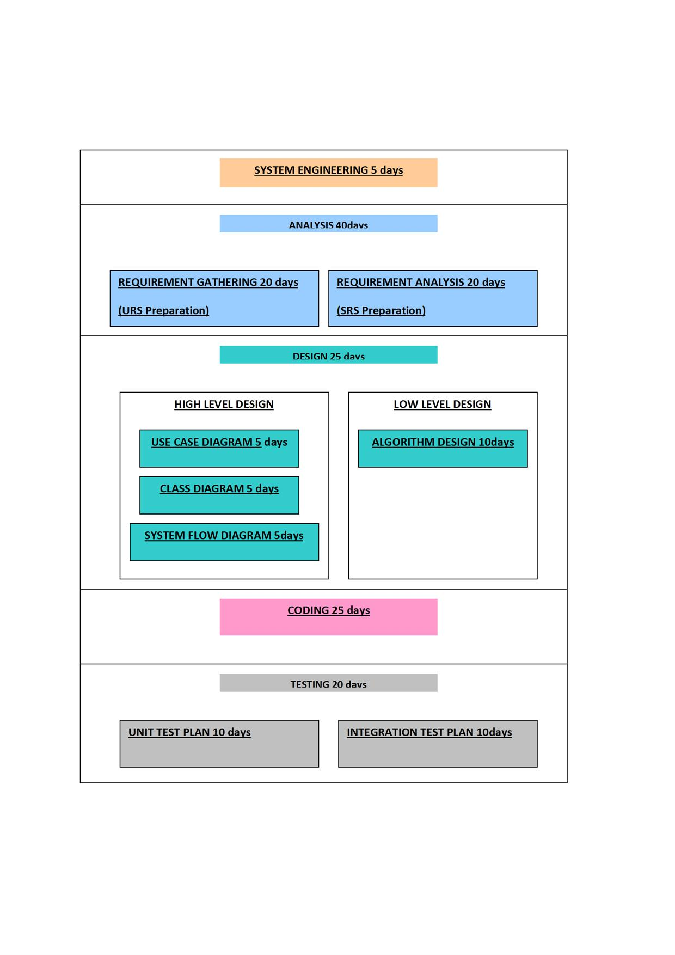

Slide 10
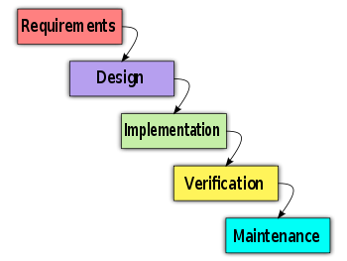
SOFTWARE MODEL(Waterfall Model)

Slide 11
Design
Low level Design
  DFD
  SFD
  CFD
  Class Diagram
  Use case Diagram.
High level Design
  GUI

Slide 12
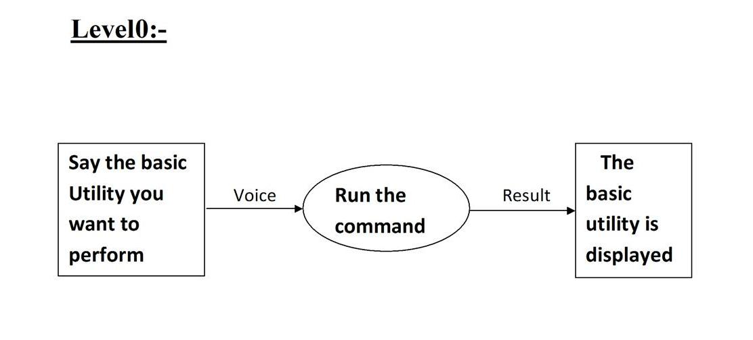
DATA FLOW DIAGRAM

Slide 13
DATA FLOW DIAGRAM

Slide 14
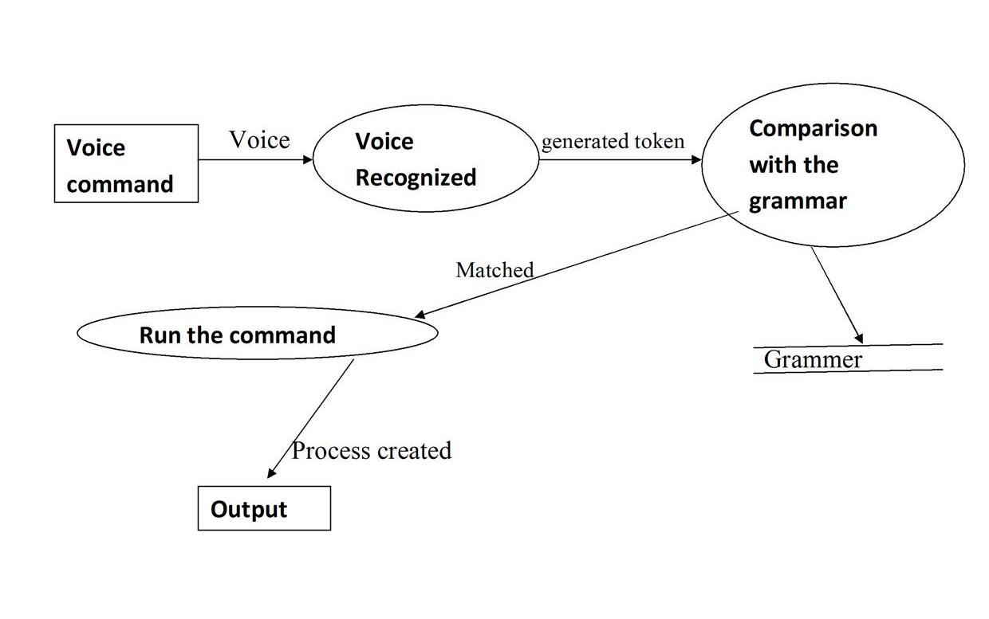

Slide 15
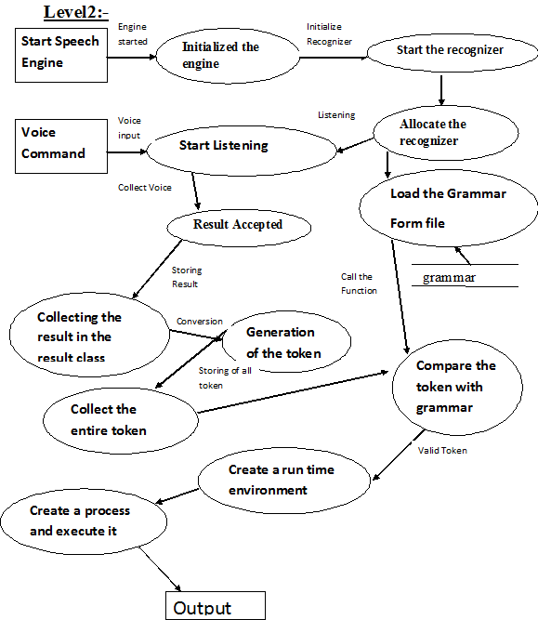

Slide 16
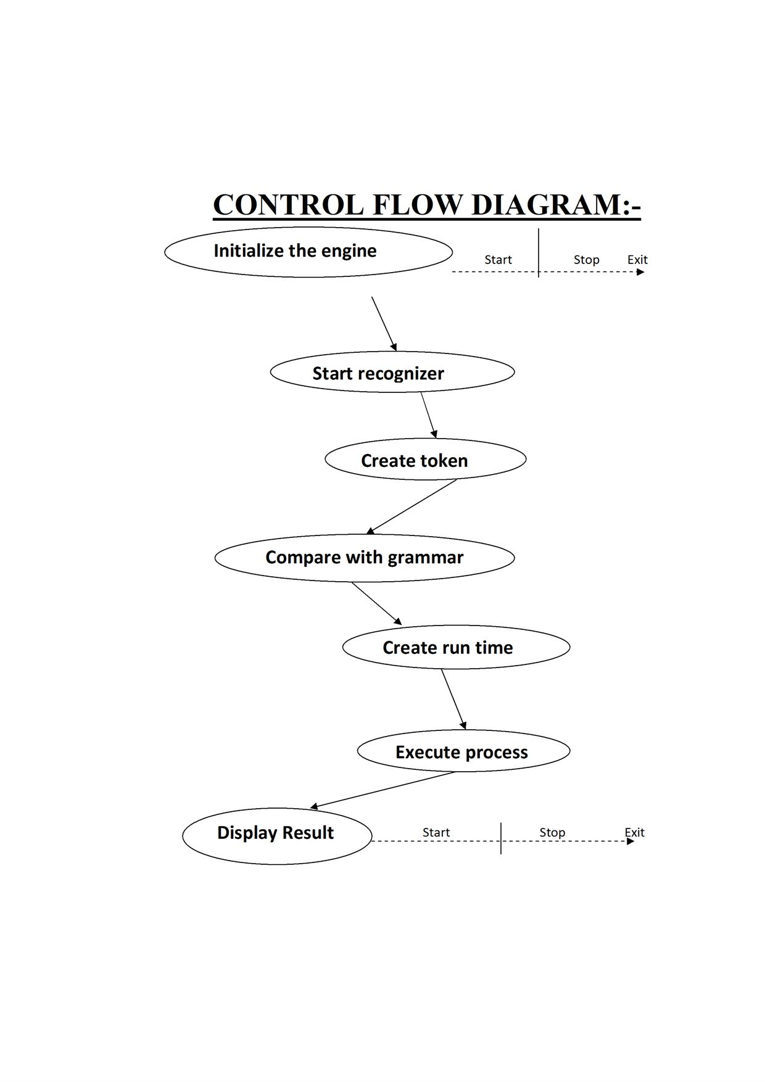

Slide 17
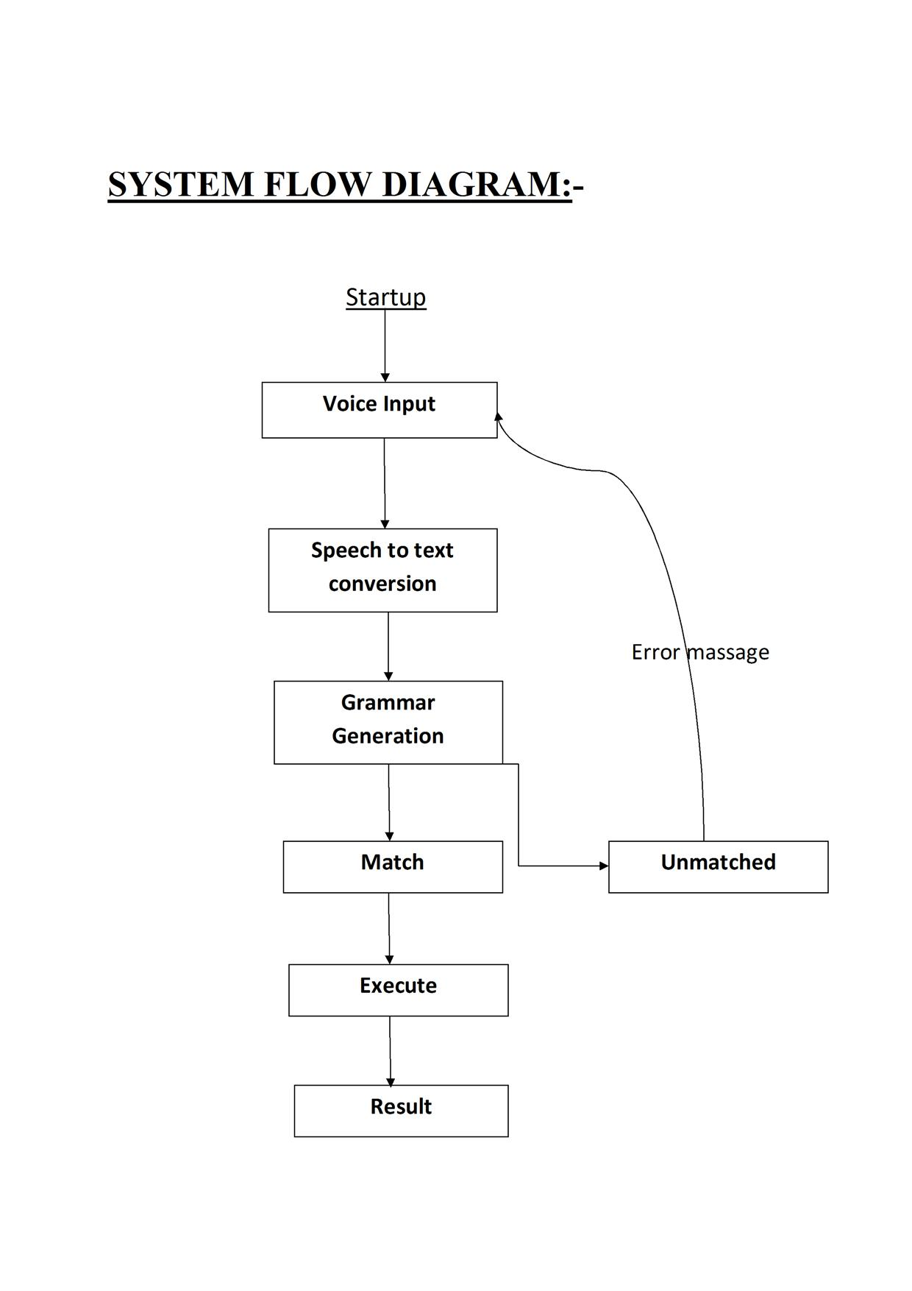

Slide 18
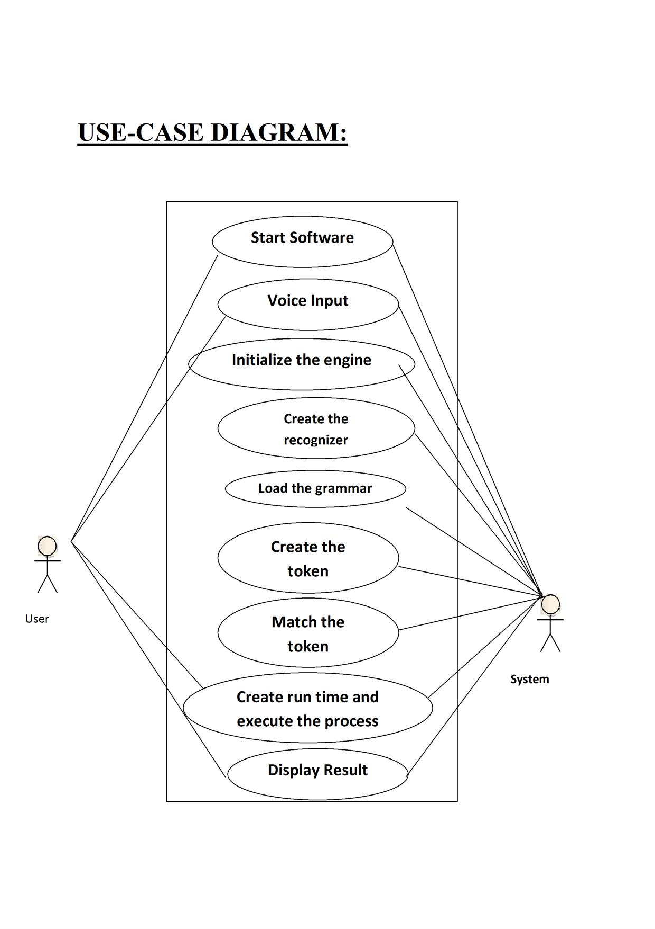

Slide 19
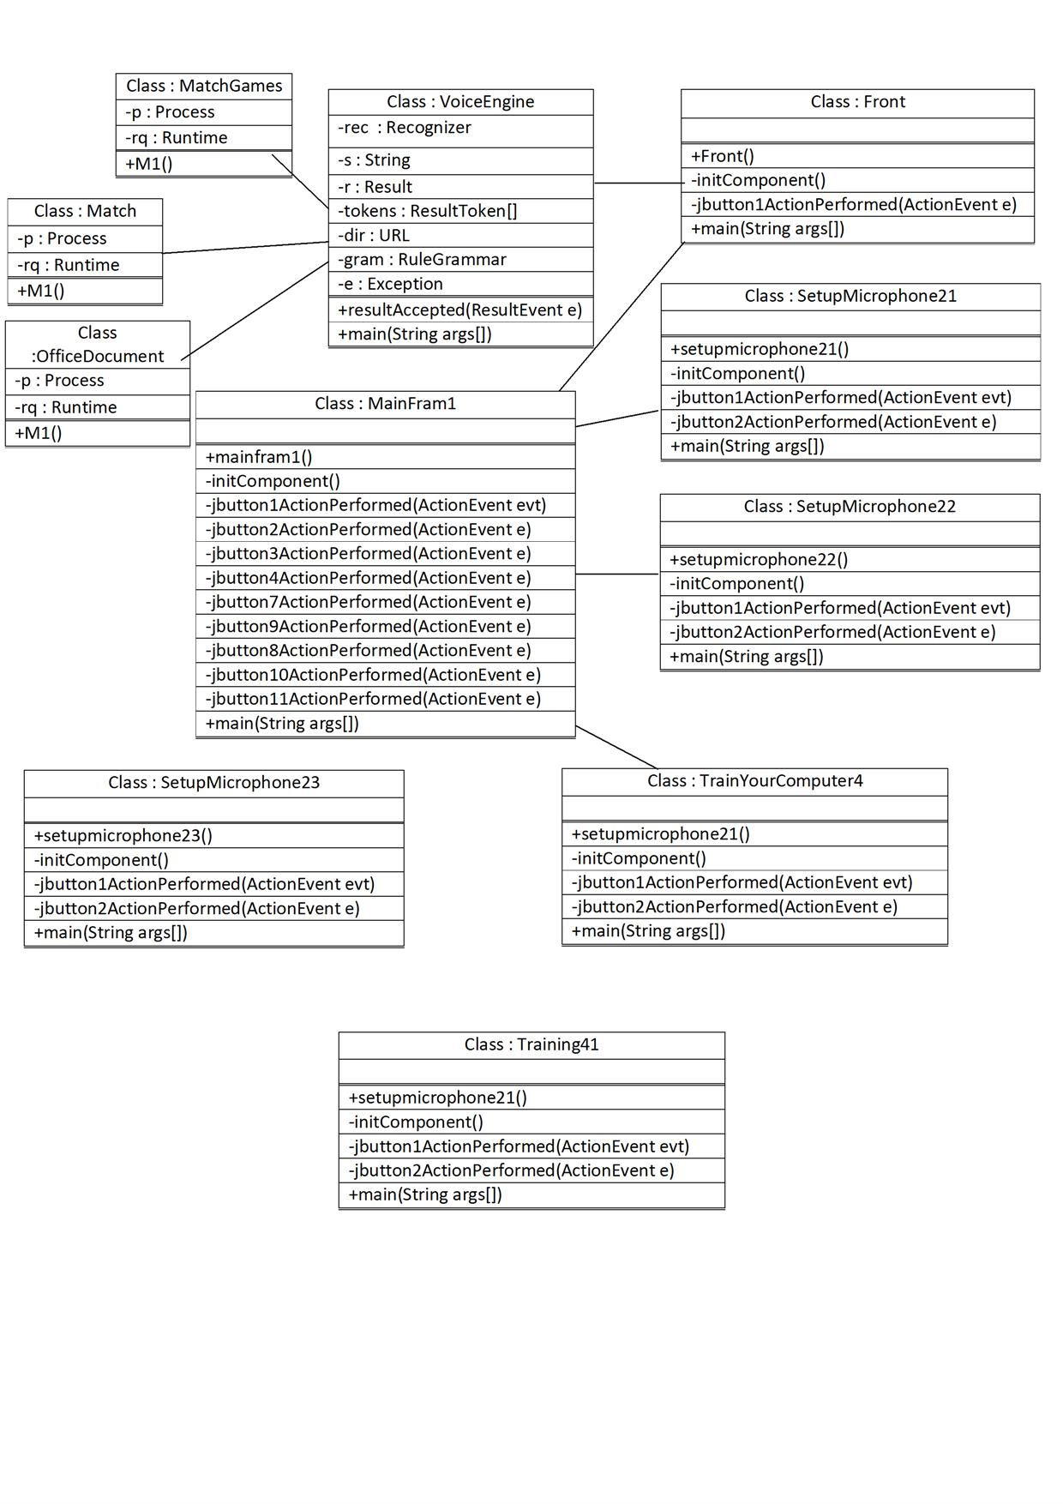
CLASS DIAGRAM

Slide 20
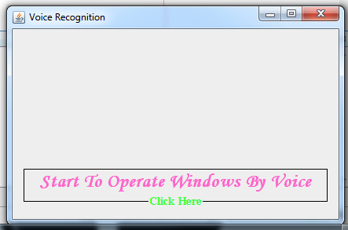
USER INTERFACE

Slide 21
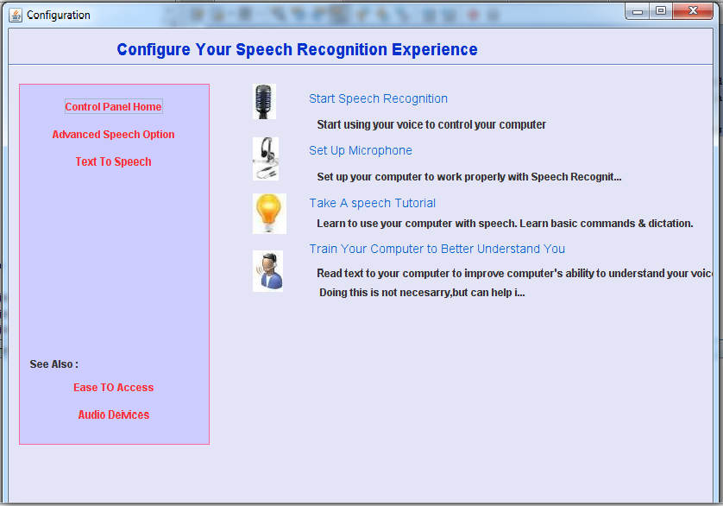

Slide 22
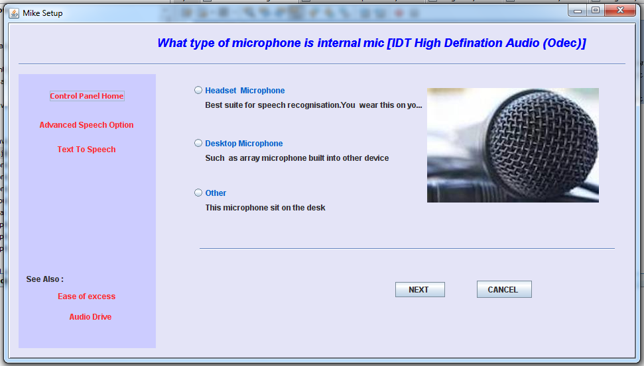

Slide 23
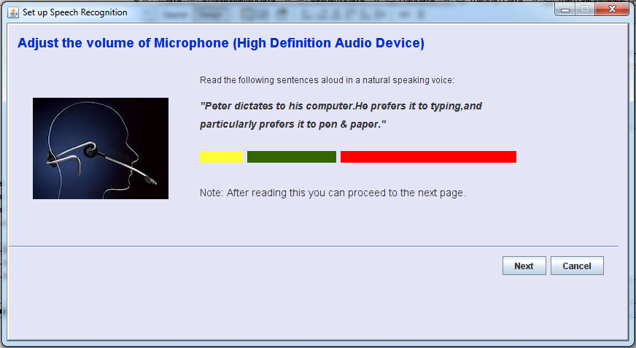

Slide 24
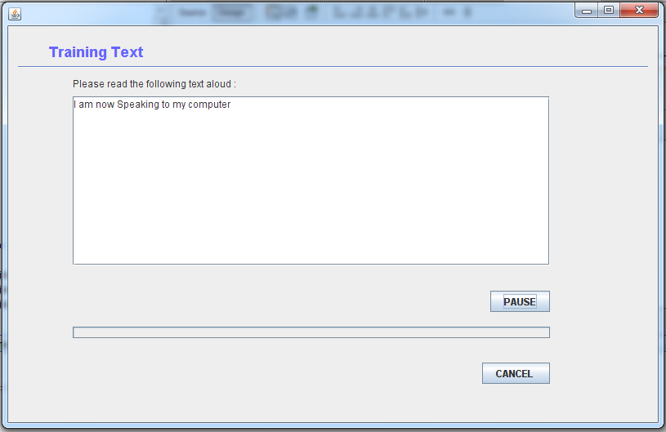

Slide 25
TOOLS USED
JAVA SPEECH API
  Cloud Garden
    Cgjsapi
    cgjsapi170_x64.dll
    cgjsapi170.dll
  NET BEANS
    NetBeans6.0
    Java(jdk1.6.0)

Slide 26
SWOT ANALYSIS
  STRENGTH
  Easy user Interface
  Portability
  WEAKNESS
  Less Security
  Crack able
  Comport should be selected manually
  OPPORTUNITY
  256 Bit Encryption may improve the security process
  We Can make it Online Also through JSP Technology
  THREATS
  Virus may destroy the software

Slide 27
BASICS OF TECHNOLOGY
Hardware Requirements:
Processor - 2.20 GHz
Ram - 256MB
Hard disk - 512MB free
Microphone- 10 to100 mill volts
S/W System Configuration
Operating system - Windows 98/XP
Java IDE - Net beans IDE 6.0
Back End - Grammar
Front End - Java JDK 1.6

Slide 28
Data Collection
This is desktop application which means it has to
be installed on any machine.
The application shall help you to control computer
through voice.
It's fast mode of operating computer.

Slide 29
Data Collection(Cont..)
It will provide the user a definite amount of “hands free” control over the computer, so that we can operate every thing with speaking to the microphone.
It's one of the best methods for operating computer even an illiterate person can operate the computer.

Slide 30
REFERENCES
 | Book Name | Written By
1. | Java Server Programming | Subrahmanyam Allamaraju
2. | Apache-The Definitive Guide | Ben Laurie, Peter Lauri
Pdf:
Java™ Speech API Programmer’s Guide
Links:
http://www.lifehack.org/articles/technology/how-to-use-windows-vista-speech-recognition.html
http://support.microsoft.com/kb/306901
http://www.nch.com.au/kb/10010.html
http://msdn.microsoft.com/en-us/library/ms695825(v=vs.85).aspx
http://www.bltt.org/text2speech.htm
http://en.wikipedia.org/wiki/Text-to-speech

Slide 31

.

